Slide 1
Covid-19 Analysis
Luddy School of Informatics, Computing, and Engineering
Anitha Ganapathy | Keerthana Reddy Varakala | Saymon Mameza
INDIANA UNIVERSITY BLOOMINGTON

Slide 2
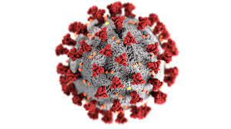
What is Covid-19
Virus that was discovered in December 2019 in Wuhan China
Originates from SARS-CoV-2
All a part of the coronavirus family
Spreads rapidly through little droplets that come from the mouth or nose

Slide 3

Outcome of Covid-19
563 million confirmed cases
6.3 million confirmed deaths
Spread to more than 180 countries

Slide 4

Fight Against Covid-19
According to the Washington Post, 90% of Americans stayed home at the start of the pandemic (April 2020)
Release and distribution of vaccines throughout 2021 and 2022
Social distancing

Slide 5

Why Should We Care About Covid-19
Killed millions and infected hundreds of millions of people
Higher age bracket has a higher mortality rate
Major shift in social and political views
Prepare for the next pandemic

Slide 6
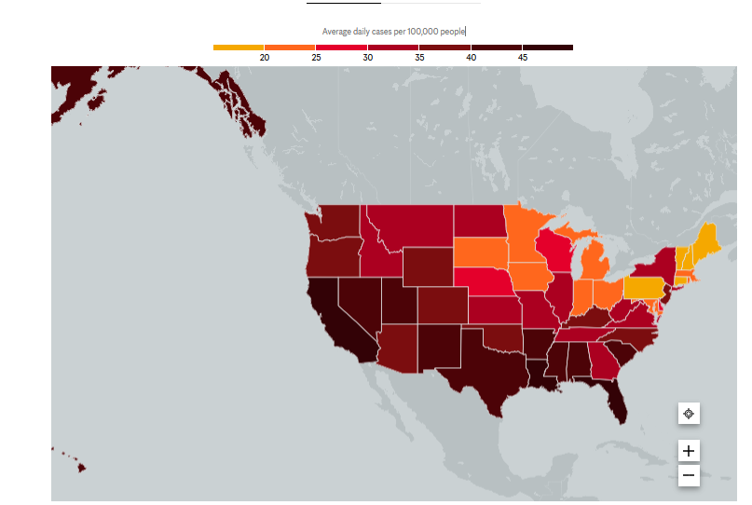
Existing Visualization
(Mayoclinic, 2022)

Slide 7
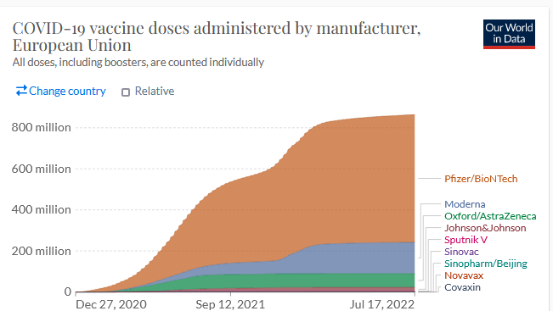
Existing Visualization
(Our World in Data, 2022)

Slide 8
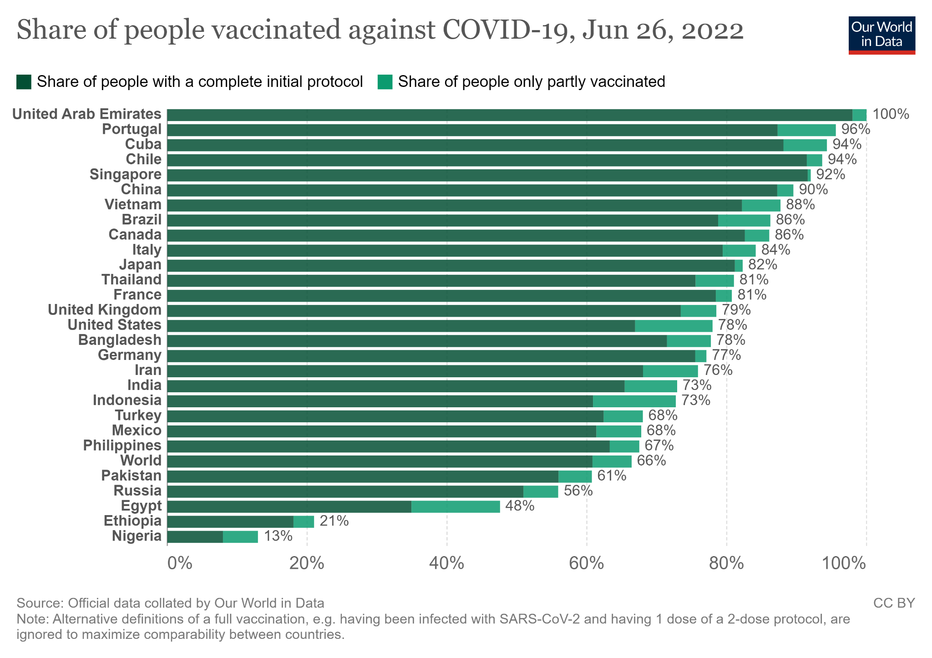
Existing Visualization
(Our World in Data, 2022)

Slide 9
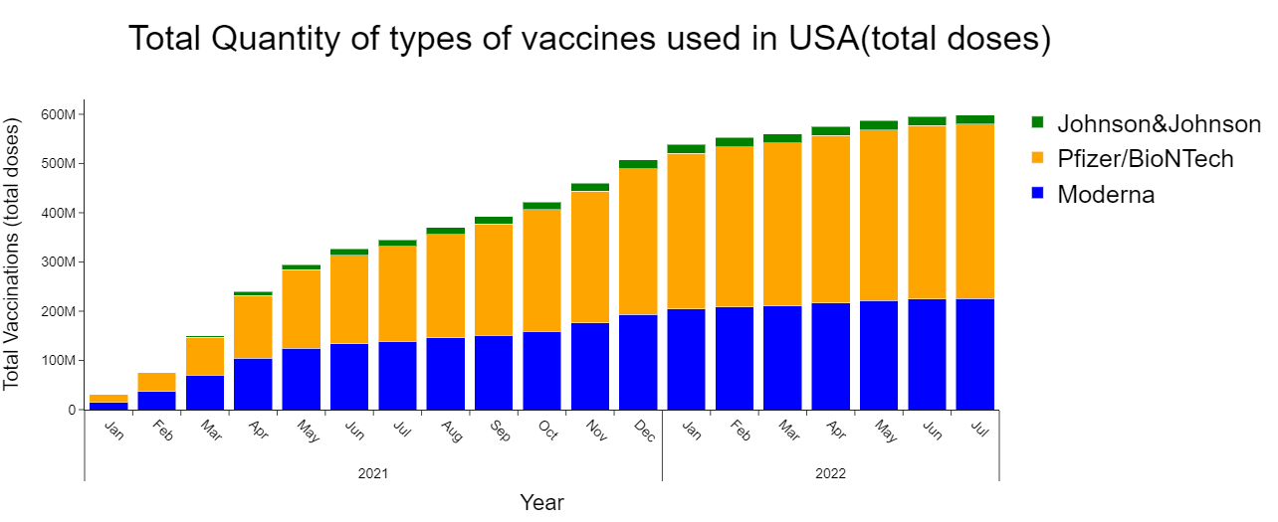
Covid-19 Team Visualizations

Slide 10
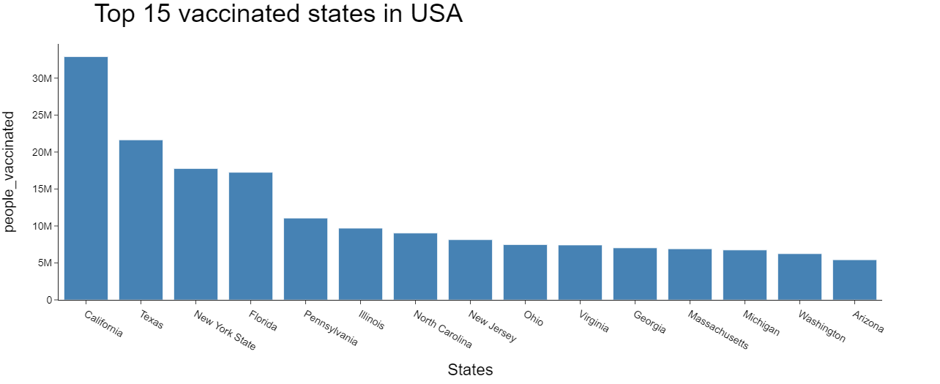
Covid-19 Team Visualizations

Slide 11
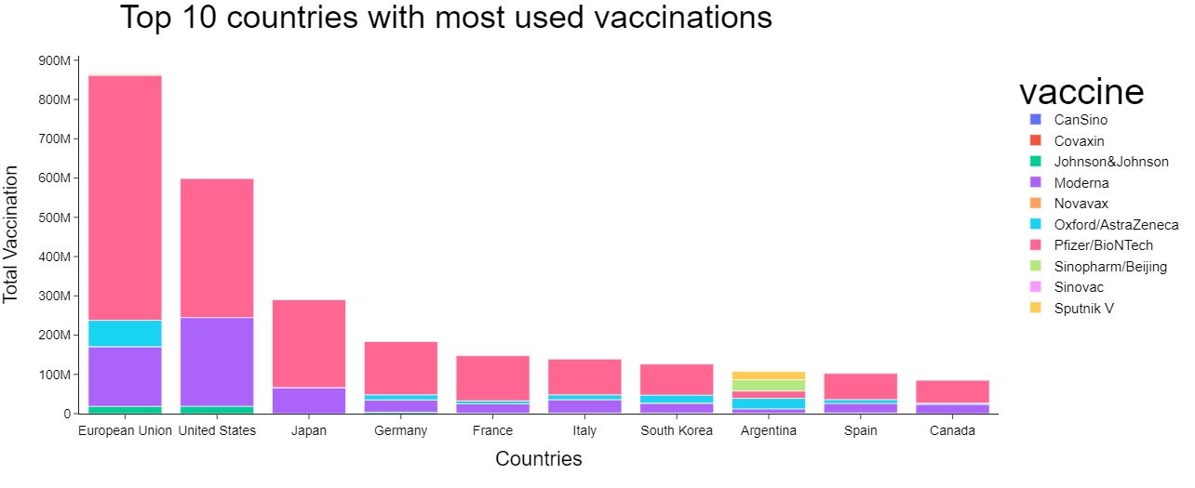
Covid-19 Team Visualizations

Slide 12
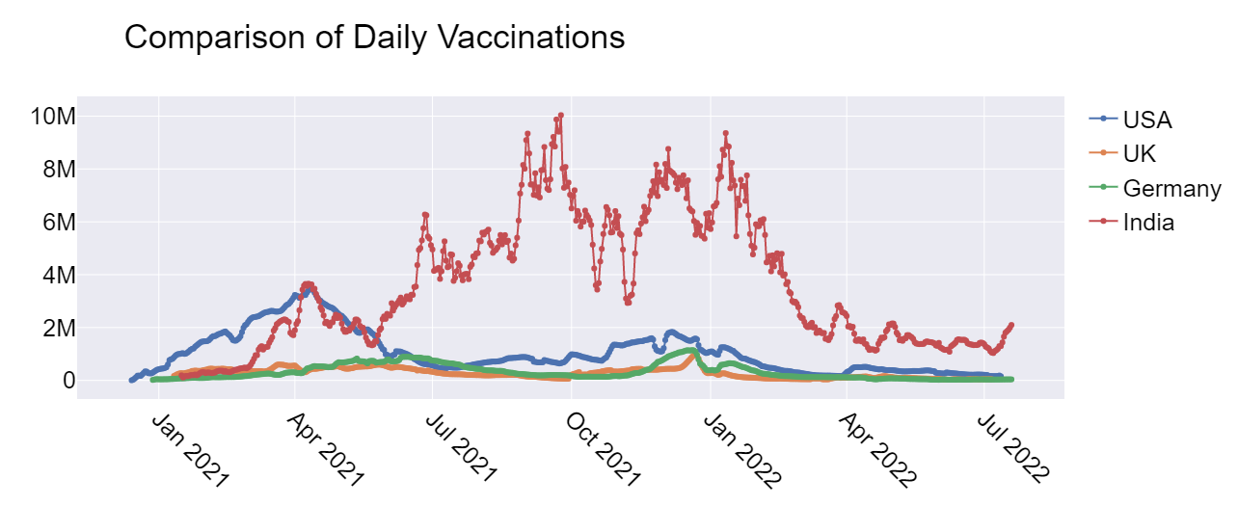
Covid-19 Team Visualizations

Slide 13
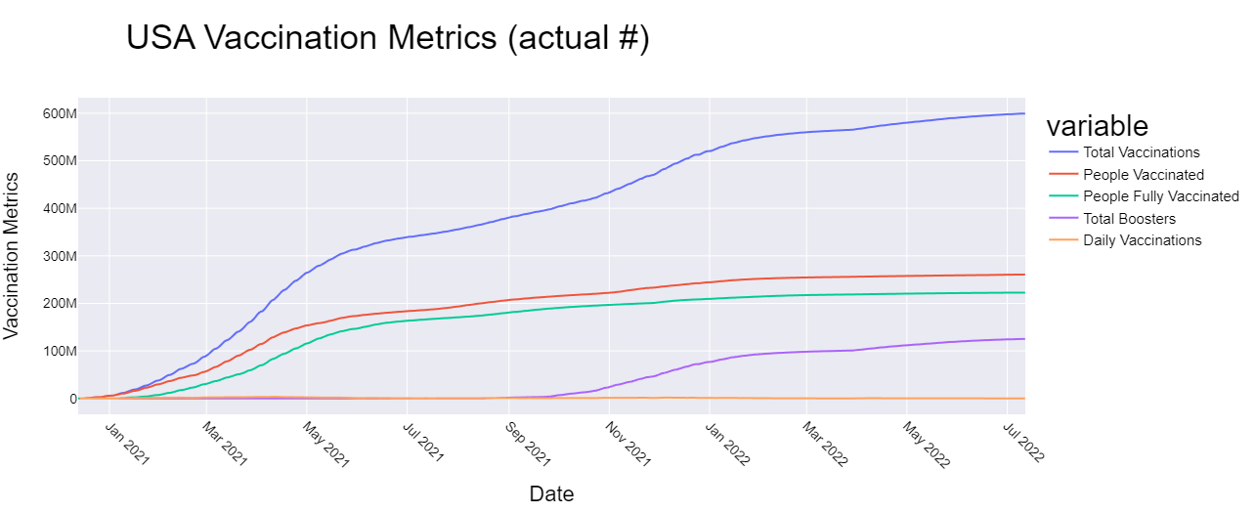
Covid-19 Team Visualizations

Slide 14
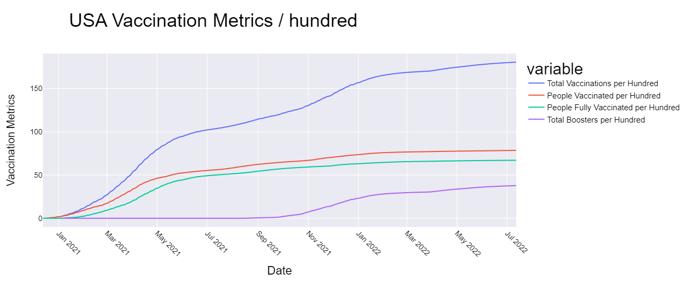
Covid-19 Team Visualizations

Slide 15
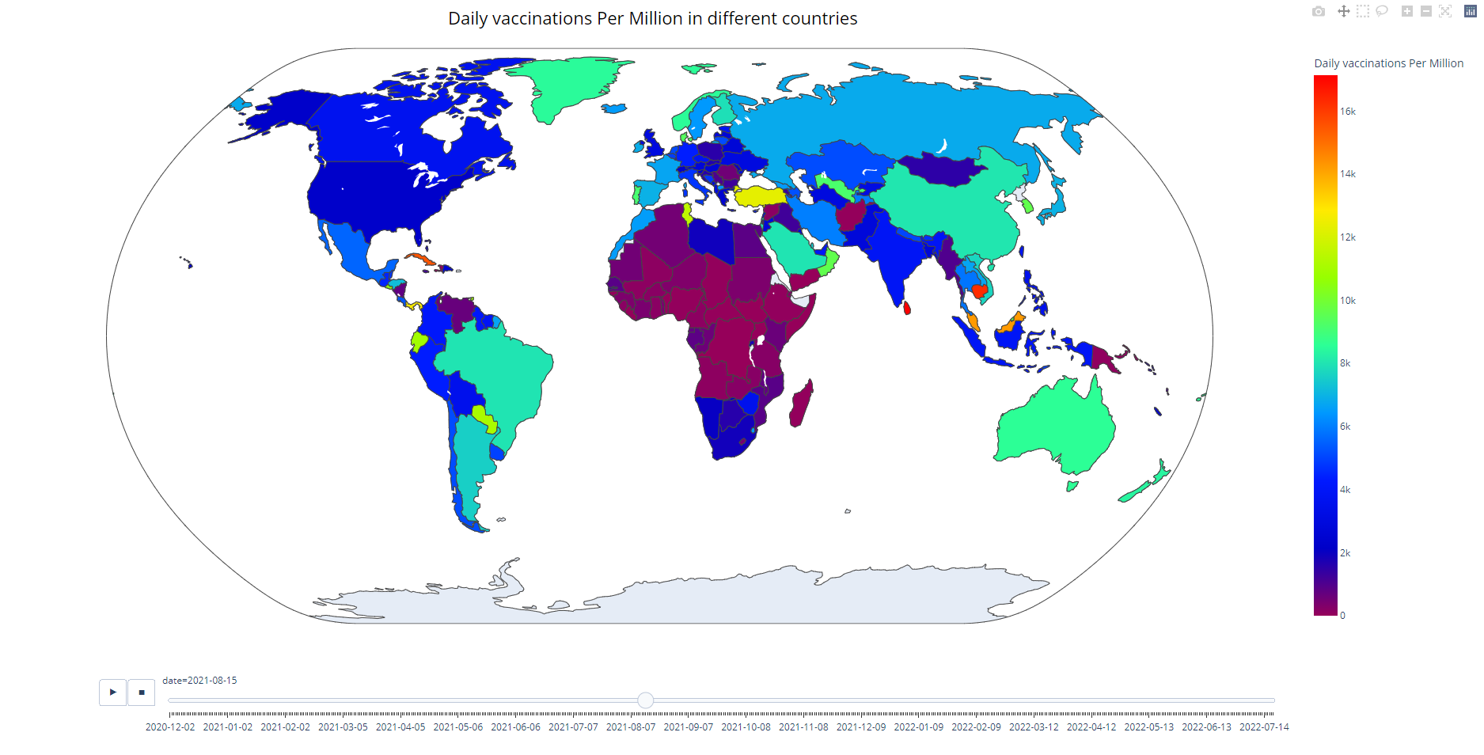
Covid-19 Team Visualizations

Slide 16
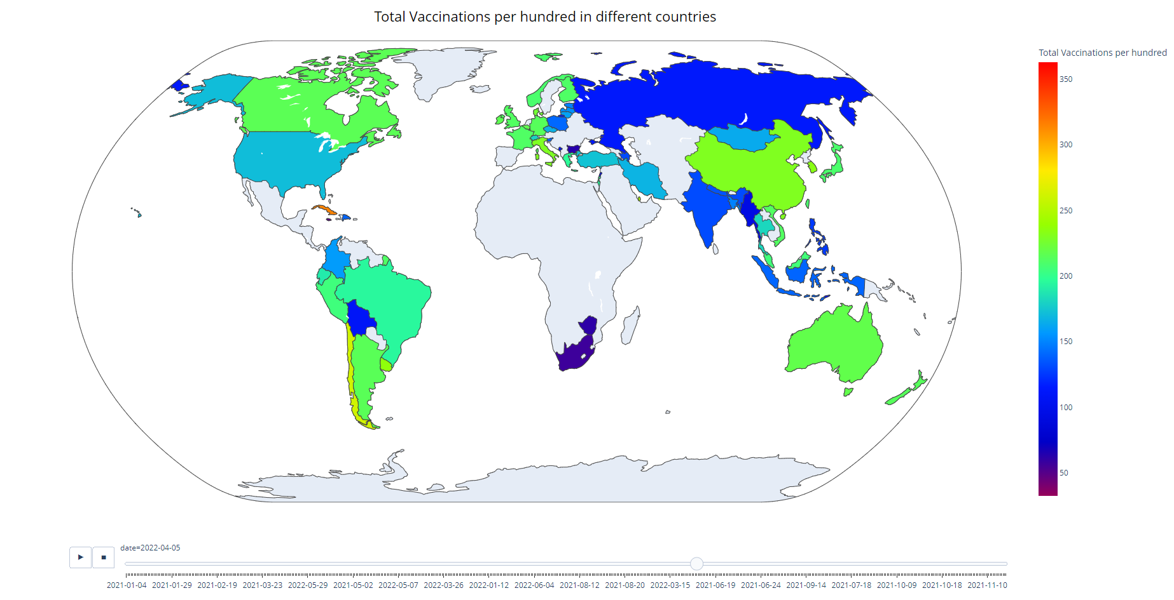
Covid-19 Team Visualizations

Slide 17
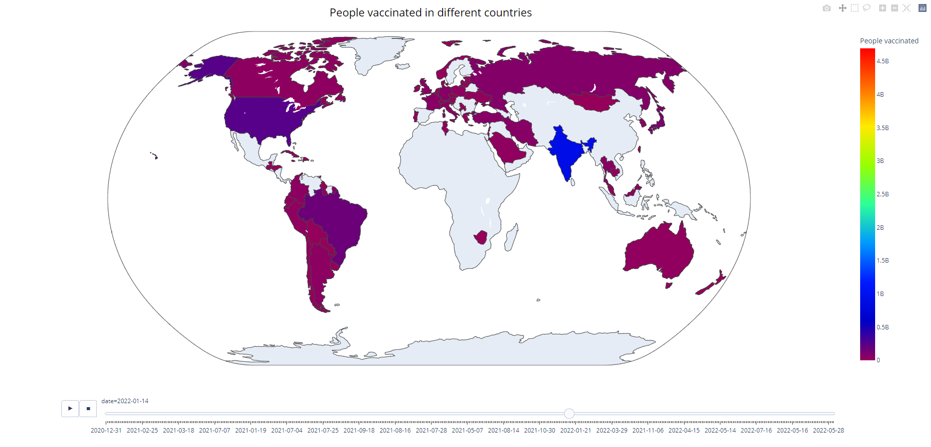
Covid-19 Team Visualizations

Slide 18
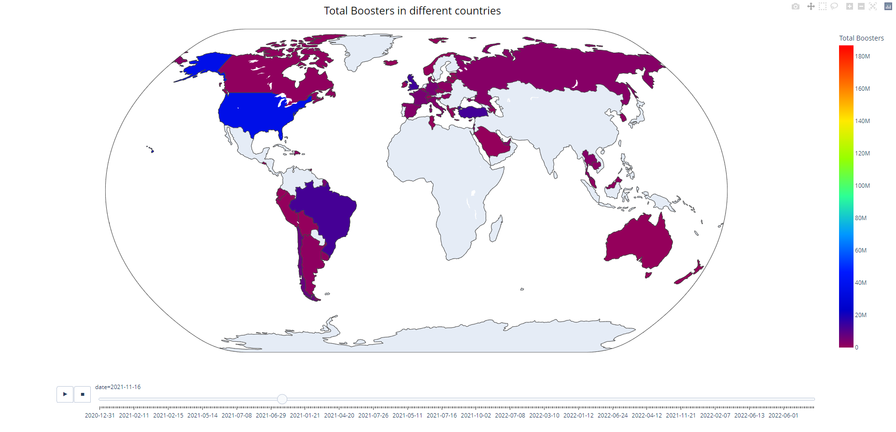
Covid-19 Team Visualizations

Slide 19
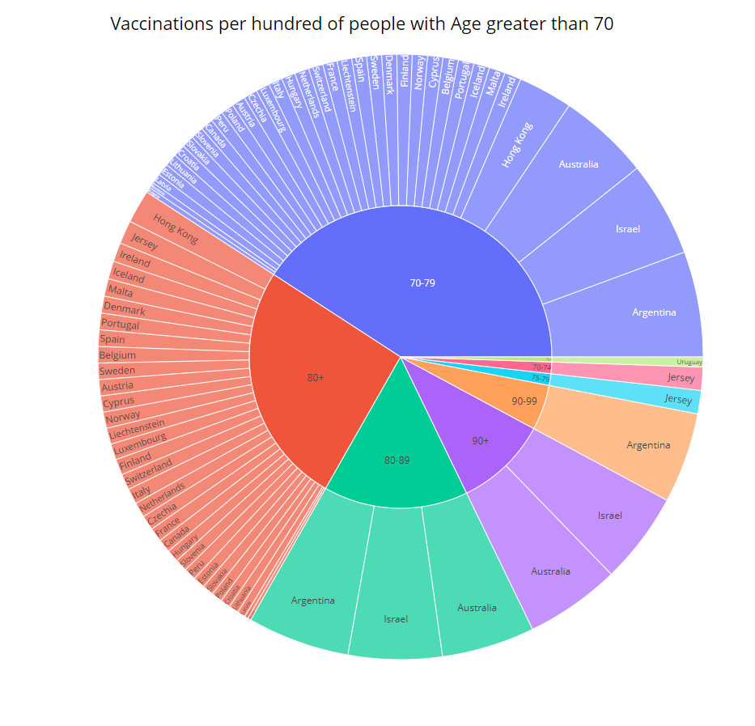
Covid-19 Team Visualizations

Slide 20
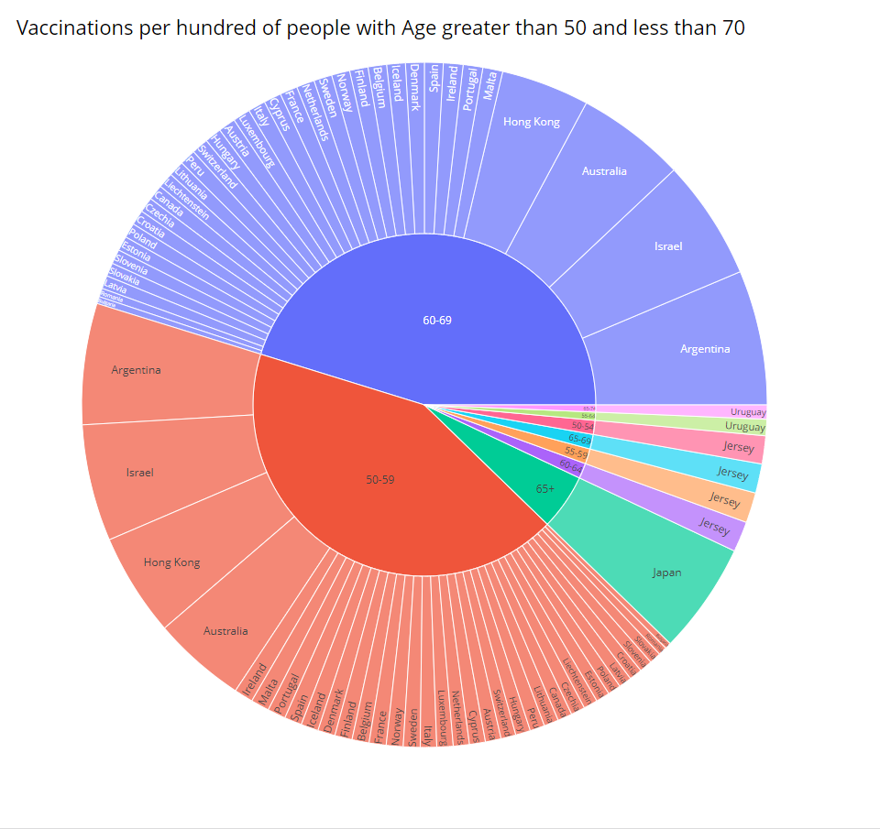
Covid-19 Team Visualizations

Slide 21
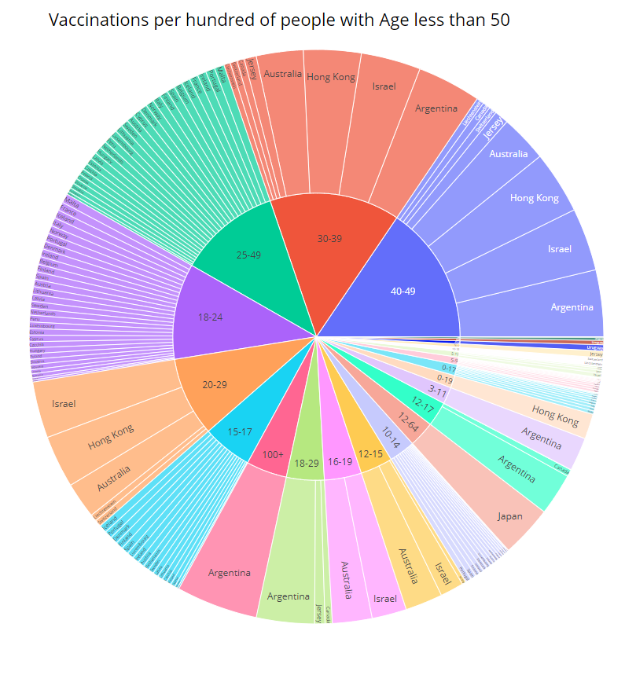
Covid-19 Team Visualizations

Slide 22
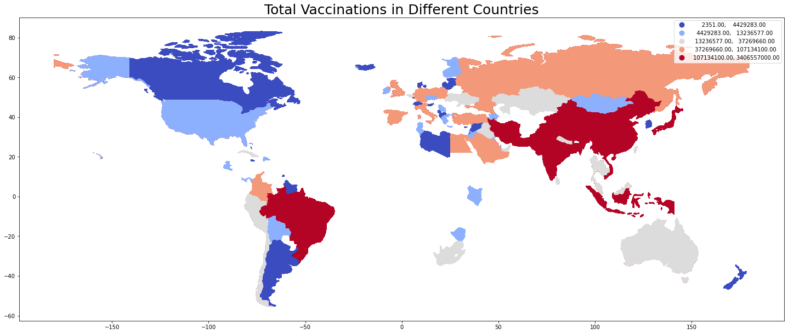
Covid-19 Team Visualizations
Total Vaccinations in Different Countries

Slide 23
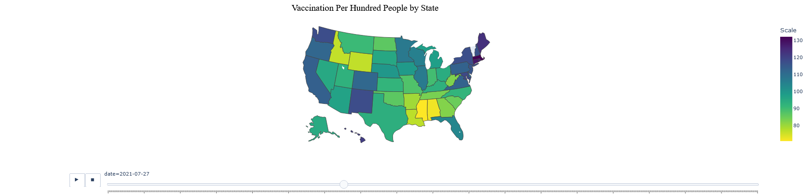
Covid-19 Team Visualizations

Slide 24
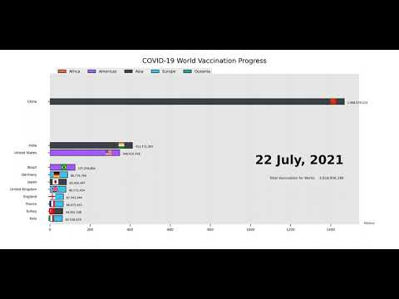
Covid-19 Team Visualizations

Slide 25

Future Work and Conclusion
Pull in more data to see the effects of Covid-19 (I.e mental health)
Run analysis on vaccination rate against Covid-19 cases

